Slide 1
Capstone Project IBM
The Battle of Neighborhoods
https://github.com/TrufflegarLaw/Coursera_Capstone

Slide 2

INTRODUCTION
There are two questions to be answered
1) Is there any similarity between two cities
2) If developer would like to open a new shopping mall, where they should open it?
For question No,1, I will use Kuala Lumpur, Malaysia and Tokyo, Japan. We know that Tokyo is a developed country meanwhile Malaysia is still a developing country. Can we find any similarity between these two cities in terms of amenity?
For question No,2, I want to focus on Kuala Lumpur only. My goal in here is to find the location that has less no. of shopping mall to prevent the oversupply

Slide 3
Hypothesis
Q1
NO SIMLARITY
Malaysia and Japan are completely two different cities
Q2
THERE WILL BE A PLACE WITH LOW NO OF SHOPPING MALLS
Should open the new shopping mall at a location that has a few or zero no of shopping malls.

Slide 4
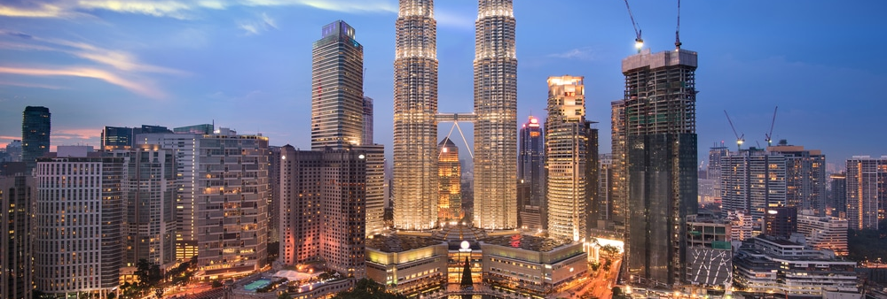
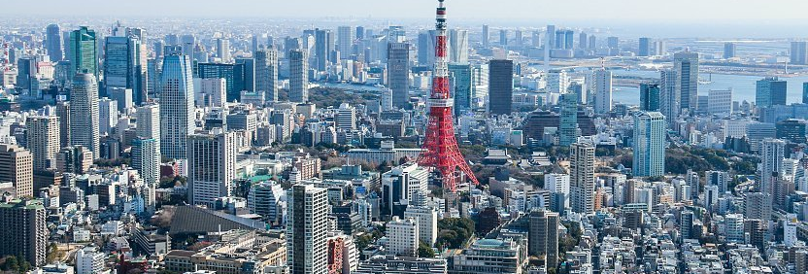
Kuala Lumpur, Malaysia
[3.139003,
101.686852]
Tokyo, Japan
[35.689487,
139.691711]

Slide 5
1. Web Scraping
2. Latitude and Longitude
Get the neighborhoods list for Kuala Lumpur and Tokyo
Get the latitude and longitude for each neighborhood by using Geocoder package.
3. Fousquare API
4. Clustering
Use Foursquare API to get the nearby venues and then group the data by neighborhood and take the average of frequency of occurrence of each category
Perform clustering on the data by using Kmeans clustering model.
5. Data Visualization
Methodology
Visualize the clusters in a map using Folium package.

Slide 6
Question 1
Find the similarity or dissimilarity of two different cities of your choice.

Slide 7
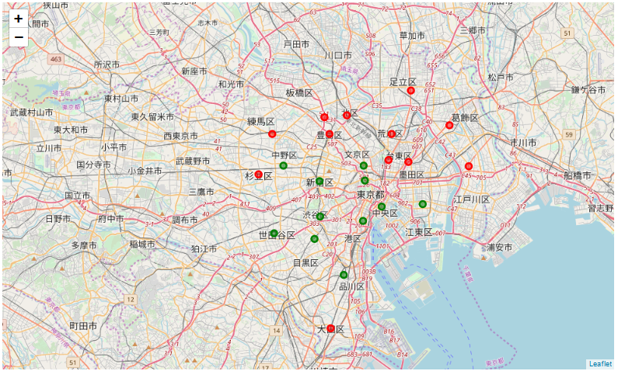
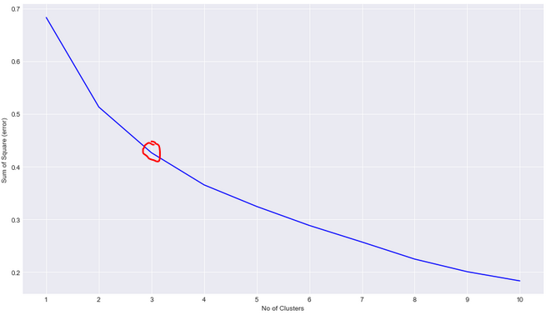
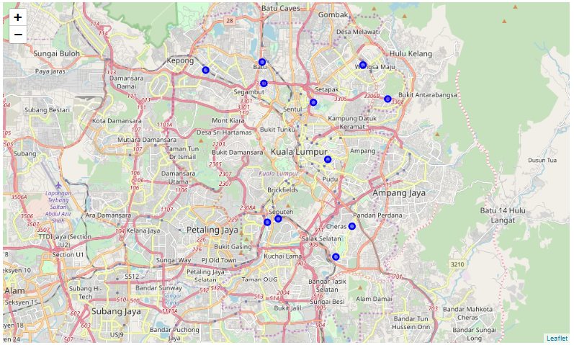
Cluster0 (red marker) and Cluster1 (green marker)
I’m using the kmeans clustering model with n = 3 as I believe it gives an optimal result.
Cluster2 (blue marker)

Slide 8
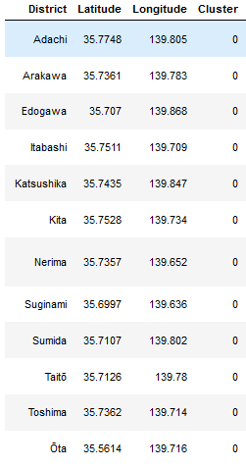
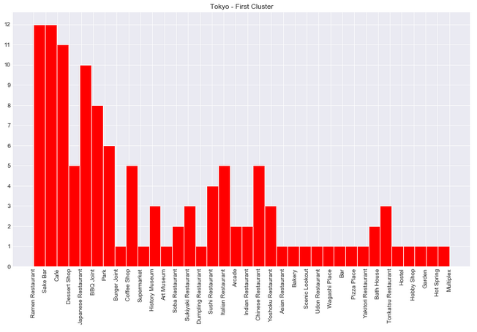
Analyze cluster0
Cluster0 consist of some of
Tokyo districts. No Kuala
Lumpur districts are found.
The top 5 most common venues:
Ramen Restaurant
Sake Bar
Café
BBQ Joint
Japanese Restaurant

Slide 9
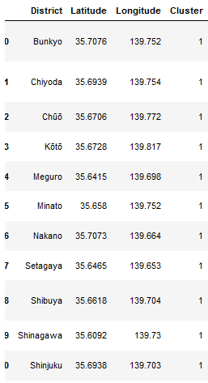
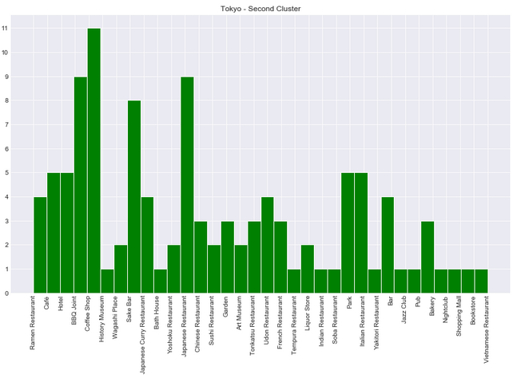
Analyze cluster1
Cluster1 consist of another part
of Tokyo districts. No Kuala
Lumpur districts are found.
The top 5 most common venues:
Coffee Shop
BBQ Joint
Japanese Restaurant
Sake Bar
Hotel/Italian Restaurant

Slide 10
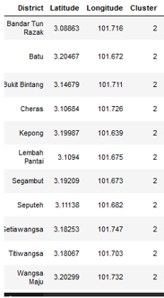
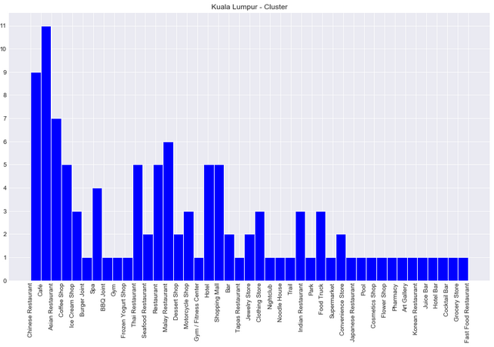
Analyze cluster2
Cluster2 consist of all Kuala
Lumpur districts.
The top 5 most common venues:
Café
Chinese Restaurant
Asian Restaurant
Malay Restaurant
Hotel/Shopping Mall

Slide 11
Question 2
Where should developer open the new shopping mall in Kuala Lumpur?

Slide 12
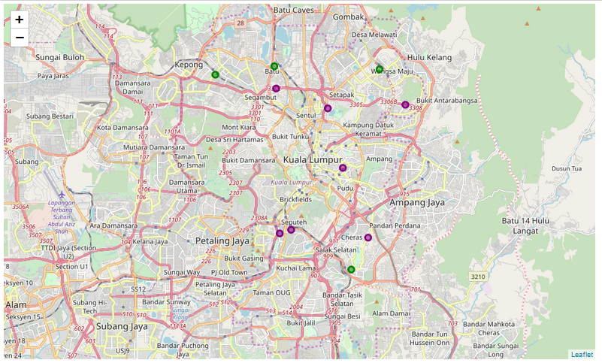
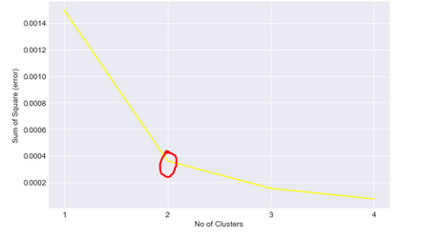
I’m using the kmeans clustering model with n = 2 as I believe it gives an optimal result.
There are two clusters formed which are in green and purple as shown in the figure on the left.

Slide 13
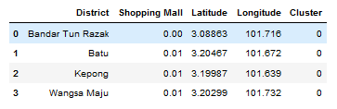
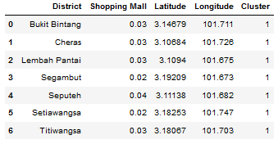
Cluster0 (green marker)
Analysis on each Cluster
As we can see, the Cluster0 has ‘Shopping Mall’ value of less and equal to 0.01.
Meanwhile, Cluster1 has the value or more than 0.01.
Cluster1 (purple marker)

Slide 14
Question 1
Question 2
From the result that I have obtained, we can see that cluster0 and cluster1 consist of Tokyo districts only and on the other hand, cluster2 only consist of Kuala Lumpur districts. Cluster0 and cluster1 have Japanese Restaurant and Sake Bar in their top 5 most common venues near the area. For Kuala Lumpur city, the most demand category is Chinese Restaurant and then followed by Café. This shows that the demand from the people who live within the area plays an important role to shape the city. As for Japanese, they love to eat Japanese/local food and enjoy drinking sake after the work time is over. Meanwhile, Malaysian loves to eat rice and usually can be found at Chinese Restaurant. They also love to spend their time having a discussion/meeting in a café.
From the result that I have obtained, I found that almost all districts of Kuala Lumpur have their own shopping malls. In this project, I use the radius of 5 km and to have so many shopping malls within this small radius indicates that there is oversupply in shopping mall. To build more shopping mall has its own pros and cons. The pros are can attract more people and therefore can encourage them to spend more and this will contribute to positive growth in GDP of a country. The cons are will be many ‘dead’ shopping malls or abandoned buildings that tear down the landscape of the area. However, there is a good location to open a new shopping mall which is at Bandar Tun Razak as the number of existing shopping mall is zero at the moment. This will give a new attraction to the place. In my point of view, shopping mall is very essential to the people as this make their life easier as they can buy everything under one roof. Therefore, it is always a demand for shopping mall and it is good to open it at a location that has less or zero number of shopping malls nearby.
Discussion

Slide 15
In a nutshell
My earlier hypothesises are true for question 1 and 2. Kuala Lumpur and Tokyo are completely two different cities and we cannot find the similarity based on amenity. This is because Malaysia and Japan have different people and culture that shape the city to be different from one another.
In Kuala Lumpur, we can cluster the districts into two which are ‘high’ and ‘low’ in terms of number of shopping malls. The best location to open a new shopping mall is in cluster0 or to be precise at Bandar Tun Razak as it has zero shopping mall at the moment.
What I can conclude?
Conclusion

Slide 16
THANK YOU
Insert the Sub Title of Your Presentation

